Slide 1

/Web Exploitation

Slide 2
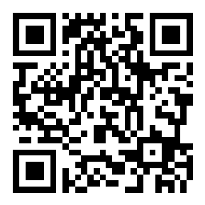
Join our Q&A
Scan the QR code to open the Q&A session
Post any questions you have during the workshop, and we'll answer them ASAP!

Slide 3
<Disclaimer!>
Please note that all content taught by NullSec is solely meant for educational purposes.

Slide 4
/What Will We Cover
/01
/What Is It?
/02
/What Are Some Common Attacks?
/03
/What's Frequently Used?
/04
/Testing The Waters
Exploitation in the web?
Learning the ways people have done it
Getting to know the different tools used
Getting your hands dirty with different tools

Slide 5
/What's a Vulnerability?
A weakness in an information system, system security procedures, internal controls, or implementation that could be exploited or triggered by a threat source.

Slide 6

/The Web: Clients and Servers
/Client
/Server
A machine/software application that accesses a cloud over a network connection, perhaps on behalf of a consumer.
A computer/device on a network that manages network resources (e.g., files, databases, printers, and databases).

Slide 7



/The Web: The Languages Powering It
/Hypertext Markup Language
/Cascading Style Sheets
/JavaScript
Defines the structure of the page, including what's in it and the order
Defines the styling and looks of the page and its elements
Defines the logic behind the page, including running dynamic code

Slide 8
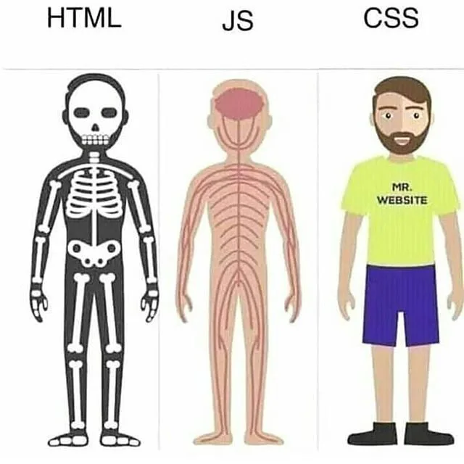
/The Web: The Languages Powering It

Slide 9
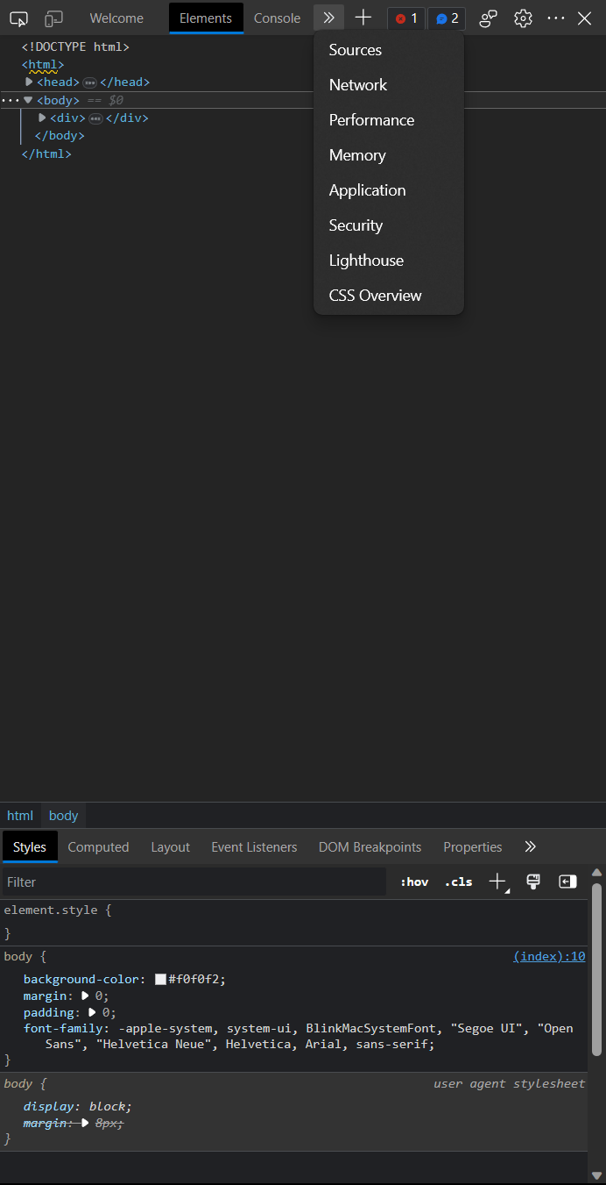
/Browser DevTools
Built right into your own browser! Each browser engine has its own variation of developer tools, but generally offer the same thing
Elements/Inspector
Console
Network
Application/Storage
How do I use it?
F12/Ctrl + Shift + I on a page
Right click > Inspect

Slide 10
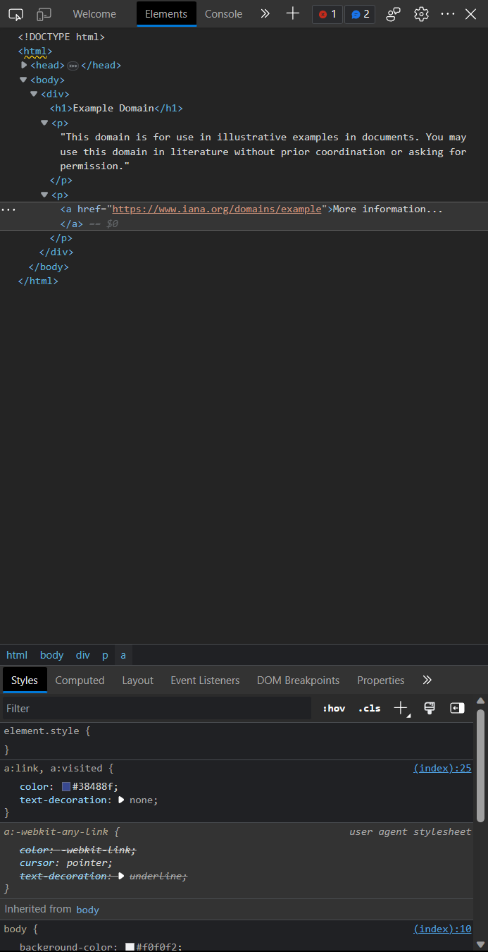
/Browser DevTools
Elements show the HTML content of a page, showing links that certain actions (e.g., forms, anchor tags) lead to
An alternative to this is right-clicking the page then selecting "View page source". It also shows the page's HTML code!

Slide 11
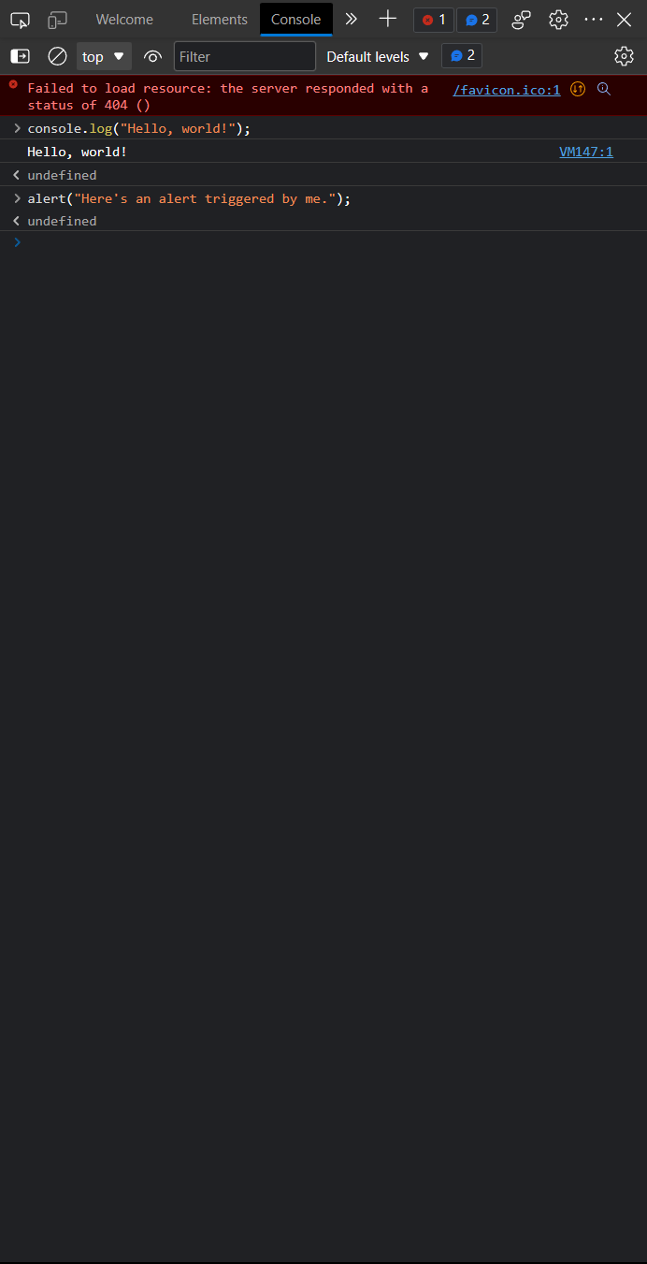
/Browser DevTools
Elements show the HTML content of a page, showing links that certain actions (e.g., forms, anchor tags) lead to
Console allows you to run JavaScript code in the browser, both in the form of writing your own code or accessing defined code (e.g., accessing variables/methods)
Notes:
TODO: Add chrome://dino game code

Slide 12
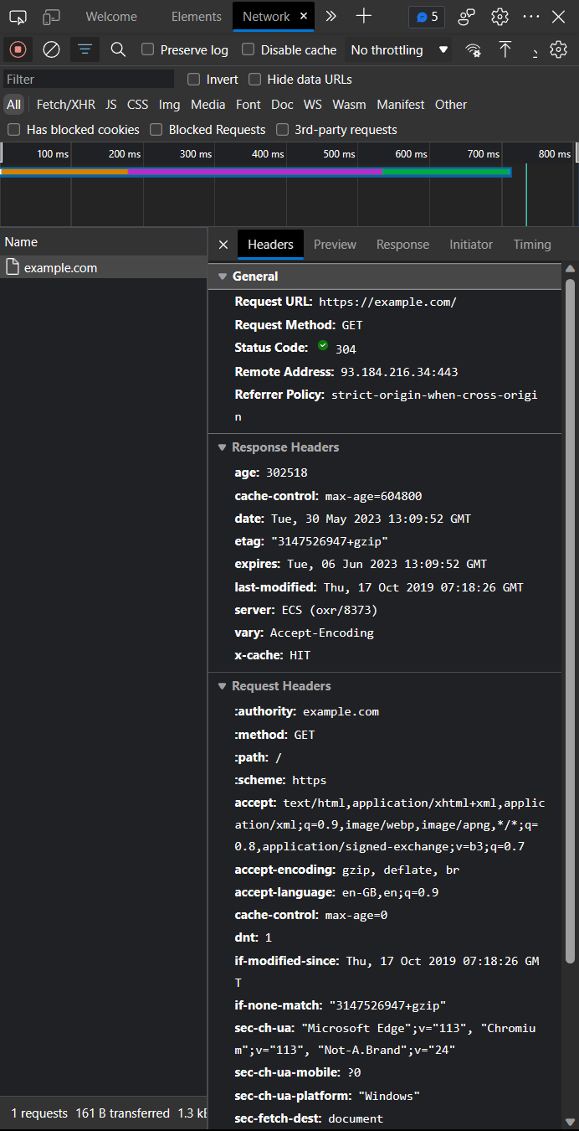
/Browser DevTools
Elements show the HTML content of a page, showing links that certain actions (e.g., forms, anchor tags) lead to
Console allows you to run JavaScript code in the browser, both in the form of writing your own code or accessing defined code (e.g., accessing variables/methods)
Network allows you to monitor HTTP requests made to the server and specific details about each request
Notes:
ToDo: Familiarize yourself

Slide 13
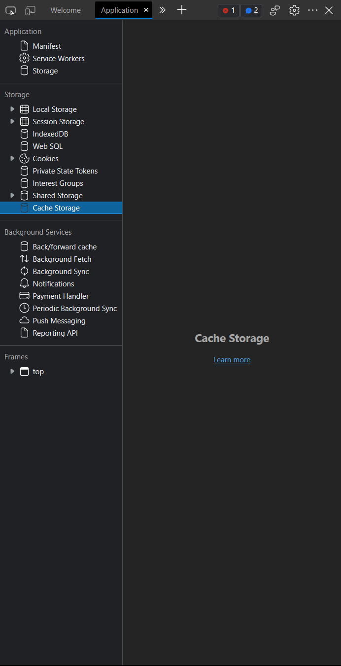
/Browser DevTools
Application (or Storage in Firefox) allows you to view all content a webpage has stored, including cookies, localStorage content, and more

Slide 14
/What Kind of Attacks are Happening the Most?

Slide 15
/Common Attacks
/01
/Cross-Site Scripting
/02
/SQL Injection
/03
/Directory Traversal
Injecting malicious code into a web page accessed by others
Exploiting vulnerable servers to extract data with SQL
Accessing files and content located somewhere in the server

Slide 16
/01
Cross-Site Scripting
Injecting malicious code into a web page accessed by others

Slide 17
/Cross-Site Scripting
/Stored XSS (Persistent XSS)
/Reflected XSS (Non-Persistent XSS)
/DOM-based XSS
Permanently stored on the target server, and all users who view the affected page are at risk.
Embedded within a URL and is immediately reflected back to the user in the response from the server.
Within the client-side JavaScript code and can manipulate the DOM (Document Object Model) directly

Slide 18


/Stored XSS (Persistent XSS)
In stored XSS attacks, the injected malicious code is permanently stored on the target server or database. Whenever the affected page is accessed, the stored script is served to all users, putting them at risk.
Request
Data
Users
Server

Slide 19
/Stored XSS: In a Nutshell
The client displays a page that accepts an input from the user.
The client then sends these inputs over to the server for it to store.
Leave a comment below...
comment
Submit

Slide 20
/Stored XSS: In a Nutshell
When another user visits the page, the client loads data received from the server.
What if the server hasn't checked what it has saved?
User1
This is cool!
comment
User2
Here's another one!

Slide 21
/Stored XSS: In a Nutshell
When another user visits the page, the client loads data received from the server.
What if the server hasn't checked what it has saved?
User1
This is cool!
<script>alert("Hello world!")</script>
This website says:
Hello world!
comment
User2
Here's another one!
OK

Slide 22
/Stored XSS: In a Nutshell
Code Snippet of the website
<!-- User Profile Page -->
<h1>User Profile</h1>
<p>Welcome to my profile!</p>
<!-- Vulnerable Comment Section -->
<h3>Comments:</h3>
<ul>
<li>Comment 1: I love this website!</li>
<li>Comment 2:
<script>
alert('XSS attack!');
</script>
</li>
</ul>
<!-- Other Profile Content -->
Let's say we have a social media website where users can post comments on user's posts. But the website fails to sanitize user input.
you can see that "Comment 2" contains a script tag. When a victim user visits the profile, the script will be executed in their browser, triggering an alert box with the message 'XSS attack!'.
Notes:
Let's say we have a social media website where users can post comments on user's posts. But the website fails to sanitise user input!
you can see that "Comment 2" contains a script tag. When a victim user visits the profile, the script will be executed in their browser, triggering an alert box with the message 'XSS attack!'.

Slide 23
/Reflected XSS (Non-Persistent XSS)
Reflected XSS occurs when user-supplied data is immediately reflected to the user in the server's response. The injected script is typically embedded within a URL and relies on the victim clicking the manipulated link.
Request
Data
Users
Server
Notes:
Attackers often craft phishing emails or social engineering attacks to trick users into clicking malicious links.

Slide 24

/Reflected XSS: In a Nutshell
The client displays a page that accepts an input from the user.
The input that the client enters is reflected one way or another back to the user.
https://example.com/search
https://example.com/search?q=query
Search
Search
You've searched for: query
Notes:
Where do reflected XSS attacks happen the most?
Generally, you might be able to find an opening whenever you see your input being reflected back to you immediately.

Slide 25
/Reflected XSS: In a Nutshell
Well, how can we make use of it? We can craft a malicious URL by injecting a script into the query parameter. For example, the following URL could be used:
http://example.com/search.html?query=<script>alert('XSS');</script>
When a user clicks on this manipulated link or visits the URL, the script <script>alert('XSS');</script> will be executed within the context of the page, triggering an alert box with the message "XSS."

Slide 26
/Reflected XSS: In a Nutshell
Code Snippet of the website
<html>
<head>
<title>Search Results</title>
</head>
<body>
<p>Your search for:
<strong>
<?php echo $_GET['query']; ?>
</strong>
</p>
<p>Results:</p>
<ul>
<!-- Display search results here -->
</ul>
</body>
</html>
Imagine a website where users can input a search term, and the website displays the search results on the page, but the website fails to sanitize user input, leading to a vulnerability.
In this code snippet, the website receives the search query from the URL parameter query using $_GET['query'] and directly echoes it onto the page without any validation or sanitization.

Slide 27
/DOM-Based XSS
DOM-based XSS occurs due to vulnerabilities in the client-side JavaScript code. The attack exploits insecure manipulation of the Document Object Model (DOM) to inject and execute malicious code.
Request
Data
Users
Server
Notes:
The slightly complicated part about DOM-based XSS is that it doesn't involve server-side vulnerabilities. This makes it harder for websites to detect and defend against.

Slide 28
/DOM-Based XSS: In a Nutshell
A website uses JavaScript to update the CSS styles dynamically based on the user's selection. However, the website fails to validate user input before injecting it into the JavaScript code.
<head>
<title>Theme Changer</title>
<script>
function changeTheme(theme) {
var userTheme = theme;
var scriptTag = document.createElement('script');
scriptTag.innerHTML = "document.body.style.backgroundColor = '" + userTheme + "';"; document.head.appendChild(scriptTag);
}
</script>
</head>
<body>
<p>Select a theme:</p>
<button onclick="changeTheme('red')">Red</button>
</body>
Notes:
The website provides buttons to change the colour theme dynamically using JavaScript. The changeTheme() function creates a new script element, sets its innerHTML property to include the user-selected theme, and appends it to the head of the document.

Slide 29
/DOM-Based XSS: In a Nutshell
An attacker can exploit this vulnerability by injecting a malicious script into the theme parameter. For example, instead of selecting one of the provided themes, an attacker can craft a URL with a malicious theme.
http://example.com/theme.html?theme=');alert('XSS');//
When a user clicks on this manipulated link or visits the URL, the script ');alert('XSS');// will be executed within the context of the page, triggering an alert box with the message "XSS."

Slide 30
/XSS Injection Practice
Here's a series of questions with XSS vulnerabilties going from easy to hard, do question 0 and 1, if you can do the rest, feel free to go ahead!
Your goal is to make an alert pop up on the screen!
http://sudo.co.il/xss/

Slide 31
/How are XSS Attacks Stopped?
/Content Security Policies
/Data Encoding
Restricts resources (e.g., scripts, images, and files) that a page can load
Restricts whether a page can be framed (embedded) by other pages
Replaces special characters so that they do not get interpreted as active content
< becomes %3E in URLs
Notes:
More on CSP
One of CSP's main points of existing is to throw off XSS attempts. By limiting what can run, CSP can directly hinder attempts by attackers to run malicious code (usually JavaScript, as we've seen!).
Read more about CSP on PortSwigger (for a more cybersecurity-oriented explanation) and MDN Web Docs (for a more general web-oriented explanation):
Content security policy | Web Security Academy (portswigger.net)
Content Security Policy (CSP) - HTTP | MDN (mozilla.org)
More on data encoding
Data encoding can be tricky because it may need to be done on many fronts (for example, for an app to be decently secure, it might need to make use of HTML, URL, JavaScript, and CSS encoding all at once!). When done correctly though, they prevent malicious code from being run by intentionally malforming them in a way that the site still can interpret (e.g., by decoding later on).

Slide 32
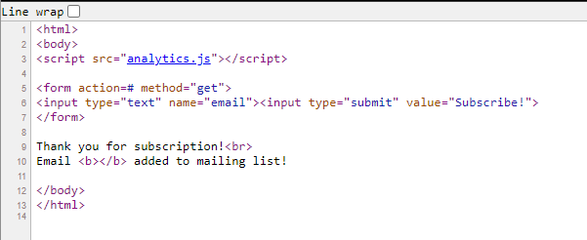
/XSS Injection Practice – Question 0
Viewing the source code reveals that there isn't anything stopping us from just using the reflective XSS!

Slide 33
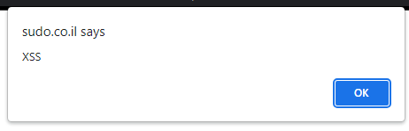
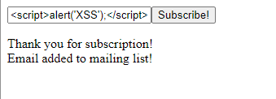
/XSS Injection Practice – Question 0
Just by inputting <script>alert('XSS');<script> we are able to make the website pop up an alert!

Slide 34

/XSS Injection Practice – Question 1
However, trying the same thing on question 1 shows up that they have upped the ante, lets look at the source code!

Slide 35
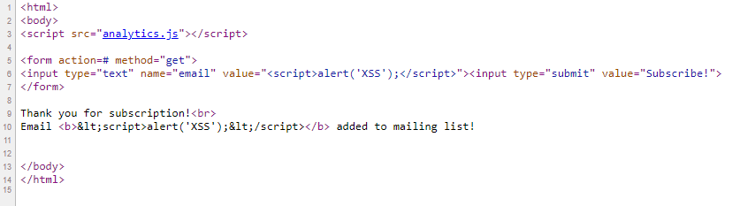
/XSS Injection Practice – Question 1
Looking at the source code... it seems like they have replaced the symbol "<" with "&lt;" which is the HTML code version. So what can we do?

Slide 36
/XSS Injection Practice – Question 1
What if we tried to trick the website? Making it believe we have not sent anything.
Take a look at the red underline. What if we inputted ">

Slide 37
/XSS Injection Practice – Question 1
What if we tried to trick the website? Making it believe we have not sent anything.
What if we inputted "> If there is something on the website that’s converting the symbol. This will bypass it!

Slide 38
/XSS Injection Practice – Question 1
What if we tried to trick the website? Making it believe we have not sent anything.
What if we inputted "> If there is something on the website that’s converting the symbol, this will bypass it!

Slide 39

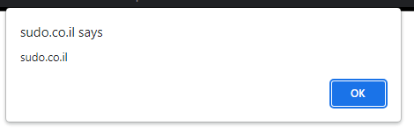
/XSS Injection Practice – Question 1
And just like that! Just by adding 2 symbols, we're once again able to make the alert pop up again! C:

Slide 40
/02
SQL Injection
Exploiting vulnerable servers to extract data with SQL

Slide 41
/What's SQL?
What’s SQL?
Structured Query Language — a standard language used to access and interact with databases (that support SQL)
Fun fact: either pronounced ‘sequel’ (historically) or by its spelling (‘ess-kew-ell’) nowadays
SQL injection then is a form of vulnerability that allows attackers to access, modify, or delete data from an SQL database without authorisation
What’s the worst that could happen?
Data theft
Website defacements
Losses in revenue
Notes:
A history lesson about SQL in general:
It has quite an extensive history, dating back all the way to the '70s!
Was first developed by IBM engineers as a way to define a definitive model for relational database management systems

Slide 42
/The SQL language
There are generally four different important commands that can be run in SQL:
Creating (using the CREATE keyword)
Reading (using the SELECT and FROM keywords)
Updating (using the UPDATE keyword)
Deleting (using the DELETE keyword)
SQL injection usually looks at when data is being read, so we try to exploit the SELECT...FROM commands!
Good news: SQL commands are English-like too!

Slide 43





/Database Management Systems
In the real world, you interact with your databases through a Database Management System (DBMS). These allow you to create, maintain, and query databases.
Even though they're all different, they're connected using SQL!
Oracle
Microsoft SQL Server
PostgreSQL
SQLite
MySQL
DBMSes
SQL
Notes:
There are many kinds of DBMSes out there, and they all bring something different to the table.
How does someone decide which DBMS they want to use?
Each DBMS may have different data types, capabilities, and use cases that might make some people prefer one for a particular use case. For example, in the industry:
MySQL: often used by a wide variety of businesses and organisations
Oracle: often used by large enterprises

Slide 44
/SQL Symbols
"Hello, SQL!"
'Hello, SQL!'
-- Hello, SQL!
SELECT * FROM users -- Hi!
/Strings
/Comments
Take note of the symbols strings can use, and that they must be closed by the same character!
Anything that comes after a comment symbol is ignored.
*IMPORTANT: Not all DBMSes use the same symbol!

Slide 45
/SQL Commands for Reading
/Selecting every column
/Selecting certain columns
/Filtering using WHERE
SELECT *
FROM table;
SELECT col1, col2
FROM table;
SELECT (* | col1)
FROM table
WHERE condition;
All rows in table with all their columns will be returned.
col1 and col2 of all rows in table will be returned.
Either all columns or col1 of rows that meet condition will be returned.
Notes:
What about line breaks?
Line breaks don't matter much to SQL, as long as you end off each statement with a semicolon (;). SQL sees anything preceding a semicolon as a group of keywords that makes up one command. These are the same:
SELECT * FROM users WHERE name = "John Doe";
SELECT *
FROM users
WHERE name = "John Doe";
SELECT * FROM users
WHERE name = "John Doe";

Slide 46
/SQL Commands for Reading
SELECT * FROM table1
UNION
SELECT * FROM table2;
Two conditions to use UNION (and this is important!):
Each query in the UNION must return the same number of columns
Each selected column must have the same data type
/Combining with UNION
All rows from table1 and table2 will be combined and returned.

Slide 47

/SQL Injection: In a Nutshell
In SQL injection attacks, the web server is the weak point: if it does not validate the user's request, attackers can form specific requests that alters the SQL statement sent to the server!
Request
SQL Statement
Data
Data
Users
Server
SQL Database
Notes:
Where does SQL injection attacks happen the most?
Generally, you might be able to find an opening whenever you see some form of input involved. Websites that are often targeted include:
E-commerce sites and platforms: people might exploit and retrieve hidden listings or even user information
Content management systems: people might exploit and retrieve content not meant for them
Usually, the following are usual targets for SQL injection attacks:
Account creation
Account updates
Making purchases
Editing an item

Slide 48
/SQL Injection: In a Nutshell
The client displays a page that accepts an input from the user.
The client then sends these inputs over to the server for it to use with the database.
Search
query

Slide 49
/SQL Injection: In a Nutshell
The server crafts an SQL statement that internally grabs data from the database.
SQL facilitates the fetching of data and returns it to the server.
What if the server doesn't check what users enter?
query
SELECT * FROM products WHERE productCode = "$query"

Slide 50
/SQL Injection: In a Nutshell
query = PA001
SELECT * FROM products WHERE productCode = "PA001"
productCode | Name | variant | price
PA001 | NullSec sticker, circular | Light | 15.0

Slide 51
/SQL Injection: In a Nutshell
The server is tricked into revealing everything!
query = " OR 1 = 1 --
SELECT * FROM products WHERE productCode = "" OR 1 = 1 -- "
productCode | Name | variant | price
PA001 | NullSec sticker, circular | Light | 15.0
NA001 | Internal product | NULL | 3499.0
PA002 | Basically everything | Oh no | 0.0

Slide 52
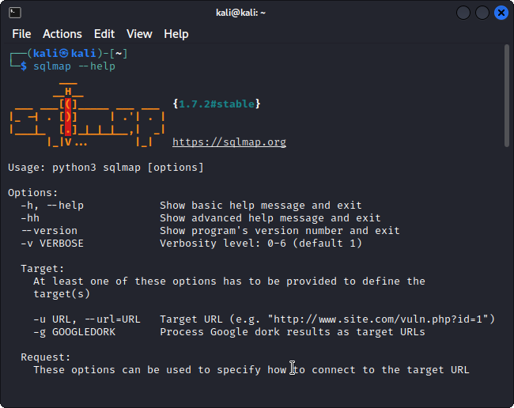
/SQLMap
SQLMap is a pen-testing tool that detects and exploits SQL injection. It can:
Detect the DBMS used for a particular database and vulnerabilities
Retrieve tables and data within the database
Notes:
More about SQLMap
We won't cover much about it during the workshop itself, but here's a basic rundown of what you need to know:
How SQLMap is usually used is by invoking its -u flag (so, to call SQLMap, run sqlmap -u <vulnerable url> in a terminal of a system that has SQLMap). The -u flag and what you pass into it refers to the URL that you want to target (as seen in the screenshot).
Command line interfaces
SQLMap is an example of a command line interface (CLI) tool, which basically means that you mainly interact with it through the terminal in a textual manner.
You can use sqlmap --help to view all the commands and flags you can pass into it.
--something and -s are known as flags: they alter the behaviour of the program, and sometimes are required inputs for the program to work.
Usually, double dashes denote 'longer' flags and some might have shorthand/abbreviated counterparts (like --url and -u in SQLMap!)

Slide 53
/Give It a Try!
Here's a helpful resource with a bunch of payloads to try: https://github.com/payloadbox/sql-injection-payload-list
Try seeing if you can inject your way through http://demo.testfire.net/login.jsp!

Slide 54
/How are Injections Stopped?
/Sanitisation
/Firewalls
Cleaning up user-provided inputs to prevent execution of unintended code through:
Escaping/Replacing characters (' → \')
Removing characters or keywords
Rule-based blocking (blocking unused SQL keywords)
Inspecting and intercepting suspicious requests
Rate-limit sources making too many attempts
Notes:
More on sanitisation
Sanitisation is pretty tricky: without context, how would the system know whether a special character is being used genuinely or for malicious intent?
Some systems entirely prevent the use of special characters, which worsens user experience (sorry O'Reillys) while ensuring security. There's always a trade-off!

Slide 55
/SQL Injection Practice
Here's a website with obvious security vulnerabilities, see if you can use SQL Injection!
http://demo.testfire.net/

Slide 56
/03
Directory Traversal
Accessing files and content located somewhere in the server

Slide 57
/Uniform Resource Locators
URLs are abundant today and are used as a guide by browsers to find resources across the web. For the next part, we'll need to know a bit about what makes up a URL!
https://www.example.com:443/info#about?q=some-text
Protocol
Port
Subdomain
Path
Domain
Fragment
Top-level domain
Query string

Slide 58
/Directory Traversal
Huh?
Servers are essentially computers with operating systems that make some files and/or folders available to the public on the internet
If a server is not properly protected, attackers can access other files and/or folders in the server!
What’s the worst that could happen?
Data theft
Website defacements
Losses in revenue

Slide 59
/Absolute and Relative paths
.
├── dirA/
│ └── a-file
└── dirB/
├── my-file
├── another-file
└── dirB-A/
└── some-file
.
├── dirA/
│ └── a-file
└── dirB/
├── my-file
├── another-file
└── dirB-A/
└── some-file
a-file from some-file:
/dirA/a-file
my-file from some-file:
/dirB/my-file
a-file from some-file:
../../dirA/a-file
my-file from some-file:
../my-file

Slide 60
/The Anatomy of a Server
.
├── boot
├── dev
├── etc/
│ └── passwd
├── home/
│ └── file.txt
├── var/
│ └── www/
│ └── html/
│ ├── index.html
│ ├── secret.html
│ ├── css/
│ │ ├── fonts.css
│ │ └── globals.css
│ └── js/
│ └── script.js
├── mnt
└── media
Servers can be considered a computer exposing certain parts of itself to the public. That's why it's important to lock down what's being shared!
What kinds of servers are there?
File servers
Web servers
Email servers
Database servers
Each of them use different tools, protocols, and software to get things up and running!

Slide 61
/The Anatomy of a Server
.
├── boot
├── dev
├── etc/
│ └── passwd
├── home/
│ └── file.txt
├── var/
│ └── www/
│ └── html/
│ ├── index.html
│ ├── secret.html
│ ├── css/
│ │ ├── fonts.css
│ │ └── globals.css
│ └── js/
│ └── script.js
├── mnt
└── media
Look to the left!
Static website server: the server is hosting a website at /var/www/html/
What files would be made available, and where?
http://example.com/ → index.html
http://example.com/css/globals.css → css/globals.css
http://example.com/js/script.js → js/script.js

Slide 62
/What If...
.
├── boot
├── dev
├── etc/
│ └── passwd
├── home/
│ └── file.txt
├── var/
│ └── www/
│ └── html/
│ ├── index.html
│ ├── secret.html
│ ├── css/
│ │ ├── fonts.css
│ │ └── globals.css
│ └── js/
│ └── script.js
├── mnt
└── media
What happens if there isn't enough protection to prevent the server's users from accessing something else on the server?
http://example.com/../../../home/file.txt → /home/file.txt
http://example.com/../../../etc/passwd → /etc/passwd
http://example.com/secret.html → secret.html

Slide 63
/Let's Try This!
Try to take some time to see if you can traverse through directories on the BWAPP file (ask your teachers!).

Slide 64
/How are Traversals Stopped?
/Validation
/Permissions
Compare the input against a whitelist of allowed values
Ensure that user input is not the only one supplying all parts of the path
Lock down access to the files and directories the public can access on the system

Slide 65
/What Have We Covered?
/01
/What Is It?
/02
/What Are Some Common Attacks?
/03
/What's Frequently Used?
/04
/Testing The Waters
Exploitation in the web?
Learning the ways people have done it
Getting to know the different tools used
Getting your hands dirty with different tools

Slide 66
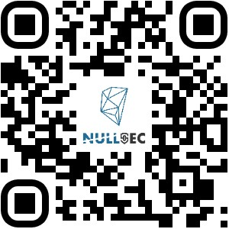
/THANKS!
/DO YOU HAVE ANY QUESTIONS?
Please do this feedback form ☺
https://forms.gle/ZedYc9hg5sK7Mpsz6

